Slide 1

GCIS-124
Software Development & Problem Solving
1: Python to Java

Slide 2


Asking for Help
Could be Improved
MUCH Better
I don't understand part 4.c. on the homework.
Part 4.c. on homework 2.2 asks us to write a function that prompts the user to enter two floating point values and to print the product.
I reviewed slides 17-18 in the lecture, and I finished the practice activity. That all works fine.
But when I try to use the values entered by the user, I am getting an "input mismatch" error. Does anyone have a suggestion?
You have all the resources that you need to solve the problems that have been given to you, but sometimes you may not be able to find the answers to the problems that you encounter.
Asking for help in this course is both expected and encouraged.
Spending time trying to solve the problem yourself will be a more valuable learning experience in the long run.
If you do ask for help, try to be as detailed as possible to make it easier for others to help you by providing as much detail as you can.
Begin by reviewing the lecture slides related to the problem that you are trying to solve
Try to solve the related class activities without looking at the answer
When asking for help, try to be as specific as possible about the problem you are having

Slide 3
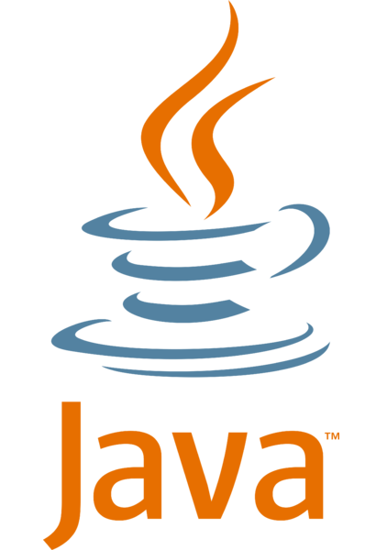

Python to Java
In GCIS-123 we wrote software exclusively in the Python programming language.
For most of the course we used procedural programming, which is a term for programs that use functions to implement most of the program requirements.
Towards the end of the course, we introduced object-oriented programming.
In GCIS-124 we will be using the Java Programming Language, a fully object-oriented language.
Unlike Python, in Java all code must be inside of a class.
During this unit we will focus on learning how to use Java to implement many of the programs that you already know how to write in Python.
Types & Variables
Methods, Parameters, Arguments & Return Values
Boolean Expressions, Conditionals & Loops
Unit Testing with JUnit
Exceptions
We will begin by focusing on procedural programming in Java.
This unit will mostly focus on showing how to use Java to do things that you already know how to do in Python. This mostly involves learning Java syntax.
As we move further into the semester, we will more deeply explore object-oriented programming, and advanced topics such as threading and networking.

Slide 4

Why Another Language?
Python is an incredibly powerful and flexible language.
It is also one of the most popular languages used today according to GitHub and Stack Overflow.
It is also a great learning language for inexperienced programmers because, while it is very powerful, it is also relatively quick and easy to pick up the basics.
"Hello, World!" is just print("Hello, World!")
However, while Python supports classes and objects, it is not a great object-oriented language.
OO concepts like encapsulation, inheritance, overriding, and overloading are all very oddly implemented in Python when compared to other languages.
There are also significant benefits to learning a new programming language.
Not only is it great for your resume, but the more languages that you learn, the more easily you will pick up the syntax of new languages.
I see that you know two languages. I'm sorry, but we only hire people who are irrationally attached to one language and unwilling to learn anything new.
Said no one, ever.
It's great to have a favorite language that is your "go to" for personal projects, but be careful not to get stuck in a professional rut.

Slide 5
Java
Java is a fully object-oriented programming language.
This means that all code must be inside the body of a class.
Python is an interpreted language, meaning that code written in a Python program is interpreted at the time of execution.
This means that any syntax or runtime errors are reported at the same time.
Java, on the other hand, is a compiled language.
Java programs are text files saved with a .java extension, e.g. HelloWorld.java.
Each must be explicitly compiled into bytecode using javac before it can be executed.
Any syntax errors are reported at this time.
The bytecode is saved in a .class file with the same name, e.g. HelloWorld.class.
Once a Java program is compiled, it can be executed using java.
The program must include a main method with a specific signature to be executed.
Any runtime errors are reported at this time.
Python is implicitly compiled and executed in a single step. Both syntax and runtime errors are reported at the same time.
Python source code
Java source code
Syntax Errors Reported
Java bytecode
Runtime Errors Reported
computer
computer
Java is explicitly compiled into bytecode first, at which time syntax errors are reported.
Once compiled, a Java program is executed as a separate step, at which time runtime errors are reported.

Slide 6
Java Bytecode
High-level languages like Python and Java are meant for humans to understand.
A higher-level language has syntax that is closer to written or spoken language.
Python is a (slightly) higher-level language than Java.
On the other hand, assembly is a very low-level language.
Machine code is very low-level code that can be executed directly on a computer.
Different computers understand different dialects of machine code.
Bytecode is somewhere in the middle.
Lower-level than Python or Java source code.
Higher-level than machine code.
Bytecode is much faster/easier to interpret (translate) into machine instructions than source code is.
A virtual machine (VM) interprets bytecode into machine code at runtime.
In this way, bytecode is like machine code for the virtual machine.
The compiled bytecode never needs to change, but a different VM is needed for each operating system and/or processor to translate it properly.
Java Source (.java)
Java Compiler (javac)
Java Bytecode (.class)
Mac
PC
Mac JVM
(java)
Windows JVM
(java.exe)
macOS Specific Instructions
Windows Specific Instructions

Slide 7
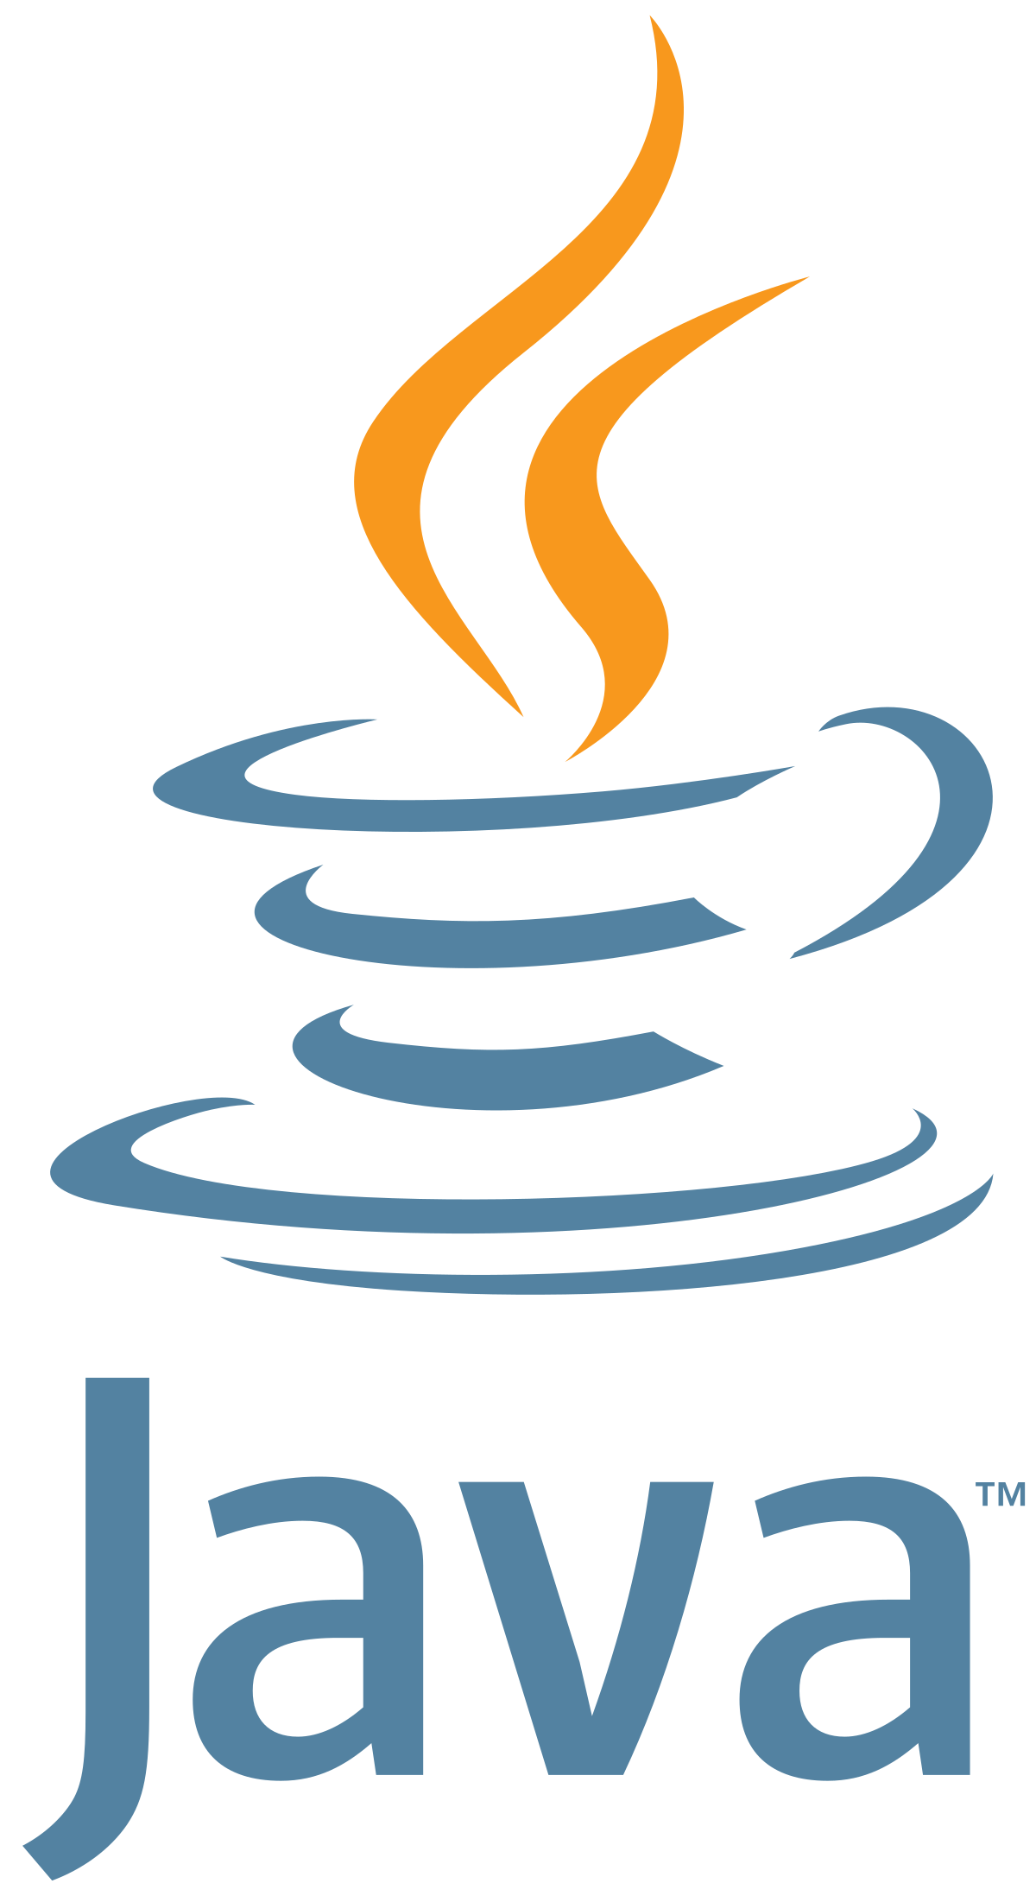
1.1
Verify Your Java Version
Before we can do anything else, you will need to make sure that the correct version of Java has been installed on your computer. Take a moment to verify that both Java and the Java Compiler have been installed and configured correctly.
Open the terminal in VSCode (CTRL-`) and run javac -version to verify the version of the Java Compiler that you have installed.
This is the executable that you will use to compile your Java programs.
Next, run the java -version command to display the version of the Java Development Kit (JDK) that you have installed.
This is the executable that you will use to run your Java programs.
Both executables should have the same version number.
dick@batcomputer MINGW64 ~/SoftDevII/unit01-nightw (main)
$ javac -version
javac 19.0.1
dick@batcomputer MINGW64 ~/SoftDevII/unit01-nightw (main)
$ java -version
java version "19.0.1" 2020-10-20
Java(TM) SE Runtime Environment (build 15.0.1+9-18)
Java HotSpot(TM) 64-Bit Server VM (build 15.0.1+9-18, mixed mode, sharing)

Slide 8
Scaffolding
Unlike Python, Java requires quite a bit of scaffolding to write even the most basic programs.
Part of the reason for this is that all code in Java must be in the body of a class, and so at a minimum a class must be declared.
Java has a C-like syntax meaning:
Whitespace is not significant beyond improving readability for humans. This includes newlines.
Statements are terminated by a semi-colon (;) and may be written on multiple lines.
Curly braces ({}) are used to indicate a block of statements, e.g. the body of a method or a class.
In Java, the static keyword marks a method or field as belonging to the class.
The method or field can be accessed through the class without first creating an object.
All of the methods we write in this unit will be static.
All Java code must be inside the body of a class, meaning that every program starts with a class declaration. The class name must match the filename, e.g. Example.java
Curly braces ({}) are used to indicate scope. Whitespace is not significant.
1 public class Example {
2 public static void main(String[] args) {
3 System.out.println("testing");
4 }
5 }
A Java class is only executable if it includes a main method with a very specific signature.
The System.out.println() method is used to print to standard output.

Slide 9
A Closer Look (or "Why we don't use Java in 123.")
In Java, using the public access modifier makes things (classes, methods, fields) accessible from anywhere outside of the class. In this unit we will make all classes and methods public.
A Java class is declared using the class keyword, just like in Python. The name of the class must exactly match the name of the file (including case), e.g. the Example class must be in a file named Example.java.
1 public class Example {
2 public static void main(String[] args) {
3 System.out.println("testing");
4 }
5 }
The static keyword indicates that the method belongs to the class and can be called without creating an object.
Whitespace is insignificant in Java. Instead, curly braces ({}) define blocks of code. Indents are used for readability only.
In Java, System.out refers to standard output. The print and println methods can be used to print virtually any type including strings, integers, and so on.
Java strings must be enclosed in double-quotes (""). You do not have the option of using single-quotes or triple-quotes of any kind.
Notes:
Python – slots
class Patient:
__slots__ = ('id', 'name', 'age')
def __init__(self, patient_id: int, name: str, age: int):
self.id = patient_id
self.name = name
self.age = age
def __repr__(self):
return f"Patient(id={self.id}, name={self.name}, age={self.age})"

Slide 10

1.2
Hello, World!
"Hello, World!" is often the first program written when learning the syntax of a new programming language. Let's start learning Java syntax by implementing it now.
Hello, again.
Create a new Java class in a file named "HelloWorld.java" in the root folder of your project.
Define a main method with the appropriate signature and print "Hello, World!" to standard output.
Open the terminal in VSCode (CTRL-`) and use the Java Compiler to compile your new class.
e.g. javac HelloWorld.java
If there are any syntax errors, correct them in the editor and try to compile your class again.
List the files in the directory to verify that your .class file has been created.
Once you have successfully compiled the class, run it using java.
e.g. java HelloWorld
Do not include the .class extension.
1 public class Example {
2 public static void main(String[] args) {
3 System.out.println("testing");
4 }
5 }
damian@batcomputer ~/SoftDevII/unit01
$ javac Example.java
damian@batcomputer ~/SoftDevII/unit01
$ java Example
testing
Notes:
Terminal → CTRL + SHIFT + ~

Slide 11
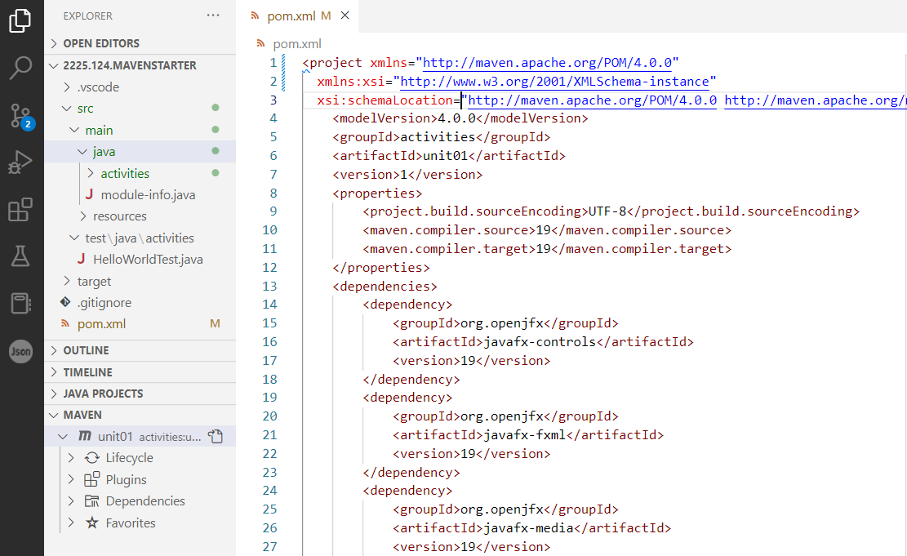
Maven
Java projects can quickly become very large and complex.
You will write programs this semester that include hundreds of lines of code in dozens of different Java class files.
It is also common that Java projects rely on third party libraries for functionality that is not included in the JDK, including some that we will be using this semester:
JUnit is a testing library similar to pytest that is used to write unit tests.
JavaFX is a set of libraries used to write Graphical User Interfaces (GUIs).
Apache Maven is a build tool that is commonly used by software engineers in industry.
It is used to organize, compile, and run Java code.
It also manages third-party dependencies by automatically downloading them from the Internet.
Maven projects must be organized in a specific way.
Your starter projects this semester will be configured to use Maven by default.
Maven projects must be organized in a very specific way so that Maven can find your Java code to compile and run it.
Everything that Maven needs to know about your project is in a file named "pom.xml". You can feel free to look inside this file, but do not modify it!

Slide 12

1.3
Verify Your Maven Version
Apache Maven is a build tool that is commonly used in industry to organize, compile, and run projects written in the Java programming language. Hopefully you downloaded and installed Maven by following the instructions for your operating system. Let's verify that now!
If necessary, open the terminal in VSCode and run the following command:
mvn -version
You should see output similar to the example below.
Make sure that Maven is using the correct version of Java to compile and run your code!
As you will see this semester, Java projects can get quite large and complex and have lots of dependencies on things like JUnit and JavaFX.
nightw@GypsyAvenger MINGW64 ~/SoftDevII/unit1-nightw (main)
$ mvn -version
Apache Maven 3.9.9 (8e8579a9e76f7d015ee5ec7bfcdc97d260186937)
Maven home: C:\Program Files\apache-maven-3.8.6
Java version: 20.0.1, vendor: Oracle Corporation, runtime: C:\Program Files\Java\jdk-20
Default locale: en_US, platform encoding: UTF-8
OS name: "windows 11", version: "10.0", arch: "amd64", family: "windows"
Maven makes building, compiling, and running Java projects with lots of dependencies relatively easy.

Slide 13
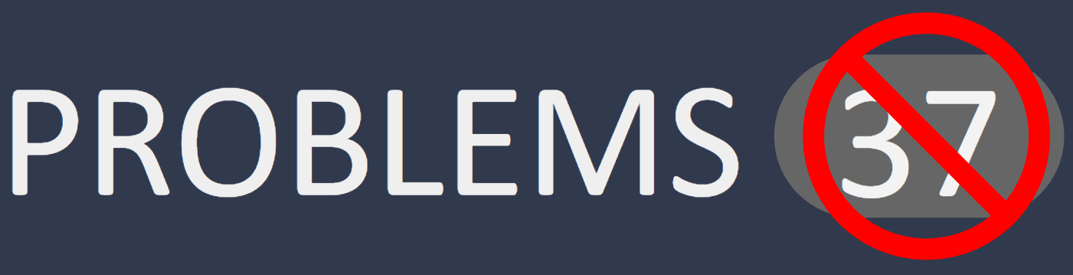
1.4
Organizing Your Code
As mentioned previously, your project must be organized in a very specific way so that Maven can find, compile, and run your code - your Java code must be located inside of the "src/main/java/unit01" folder in your project. Let's move the code that we have written so far so that it is in the right place for Maven to find it.
Expand the "src/main/java/unit01" folder in your project.
Move the "HelloWorld.java" class into the folder by clicking and dragging it.
If VSCode does not automatically add "package unit01;" to the top of your file, you will need to add it manually.
Java packages are a way of organizing your code. We will discuss Java packages in more detail in the near future.
Open the PROBLEMS tab in VSCode and make sure that you do not have any errors.
If there is an error that you cannot solve on your own, please raise your hand!
You may need to close and reopen the file for the errors to go away.
If all else fails, restart VSCode!
Packages are a way to organize Java code by placing related classes in the same folder.
You must use a package statement that matches the name of the folder!
package unit01;
public class HelloWorld {
}

Slide 14
Variables & Assignment
Java is a statically typed language, meaning that the type of a variable must be specified when it is declared.
Once declared, only compatible values may be assigned to the variable.
Unlike Python, a Java variable may be declared without immediately assigning a value.
e.g. int radius;
Variables may also be declared and initialized at the same time, e.g. double pi = 3.14159;
Like Python, Java includes two basic kinds of types.
Primitive types include integers, floating point values, characters, and booleans.
Primitive types are very similar to Python's value types.
Java includes a character type, a single character enclosed in single-quotes, e.g. char c = 'c';
Reference types are, well, everything else including strings, arrays, and other objects.
Reference types work the same in Java as they do in Python.
Type | Description | Example
byte | 8-bit signed integer, -128 to 127. | 123
short | 16-bit signed integer. | 12345
int | 32-bit signed integer. | 1234567
long | 64-bit signed integer. | 1234567l
char | 16-bit unsigned integer (Unicode). | 'a'
float | 32-bit signed floating point value. | 3.14159f
double | 64-bit signed floating point value. | -0.1234
boolean | Boolean value; true or false. | true
Java assumes that literal numbers are int or double, and so a suffix of l (lowercase L) is needed for a long literal (e.g. 3098765341l), and f for a float literal (e.g. 1.3f).
Notes:
Talk about python dynamic type
>>> a = 10
>>> a
10
>>> a = "abc"
>>> a
'abc'

Slide 15
A Closer Look at Variables in Java
1 public static void variables() {
2 double weight = 65.5;
3
4 int age;
5
6 age = 10;
7
8 System.out.println("weight = " + weight
9 + ", age = " + age);
10 }

Slide 16
A Closer Look at Variables in Java
Because Java is a statically typed language, variables must be declared with a valid type. Only values of a compatible type may be assigned to the variable.
Like any other statement in Java, a variable declaration must be terminated with a semicolon.
1 public static void variables() {
2 double weight = 65.5;
3
4 int age;
5
6 age = 10;
7
8 System.out.println("weight = " + weight
9 + ", age = " + age);
10 }
Unlike Python a variable may be declared without immediately assigning a value…
…but a value must be assigned before the variable can be used.
Unlike Python, the + operator can be used to concatenate any type onto a string (not just other strings).
Notes:
Python, data type is inferred from value it is assigned to

Slide 17

1.5
Primitive Types
Primitive types in Java include integers (byte, short, int, long), floating point values (float, double), characters (char), and boolean values. Practice declaring a few variables using different primitive types and printing them to standard output.
Create a new Java class in a file named "Primitives.java" in the "src/main/java/unit01" folder.
Define a main method with the appropriate signature.
Declare variables of at least four different primitive types and print the name, type, and value to standard output.
e.g. int x = 5;
Hint: unlike Python, you can concatenate a value of any Java type onto a string using the + operator, e.g. System.out.println("four = " + 4);
Use the "play" button in VSCode to run your class.
public static void variables() {
String name = "Buttercup";
int age;
age = 10;
System.out.println("name = " + name
+ ", age = " + age);
}

Slide 18
Arithmetic Operators
Java supports most of the same basic arithmetic operators that Python does with a couple of notable exceptions.
There is no power (**) operator in Java, but the Math.pow() method may be used instead, e.g. Math.pow(2, 7) will return 2⁷ = 128.
There is no integer division operator (//) in Java, but using standard division with two integer values has the same result.
The other basic operators all work the same with some possible caveats.
Applying an operator to two values of the same type will produce a value of that type.
For example, 10 / 3 will perform integer division. In this case, the expression would evaluate to an int (3).
If values of different types are mixed in the same expression, the result is "promoted" to the most complex type.
For example 2.5 * 3 would evaluate to a double (7.5).
Operator | Description | Example
+ | Addition | double x = 5.1 + 3;
- | Subtraction | double z = 5.1 - 3;
* | Multiplication | int x = 3 * 4;
/ | Division | double x = 5.1 / 3;
/ (integers) | Integer Division | int x = 5 / 2;
Math.pow(x, y) | Power: X^{Y} | double z; z = Math.pow(x, y);
% | Modulo | m = 10 % 3
The + operator also works for string concatenation, just as it does in Python. A notable difference is that any type can be concatenated onto a string without using a function like str(), so "abc" + 123 is valid.
Notes:
Python ** → Java Math.pow

Slide 19
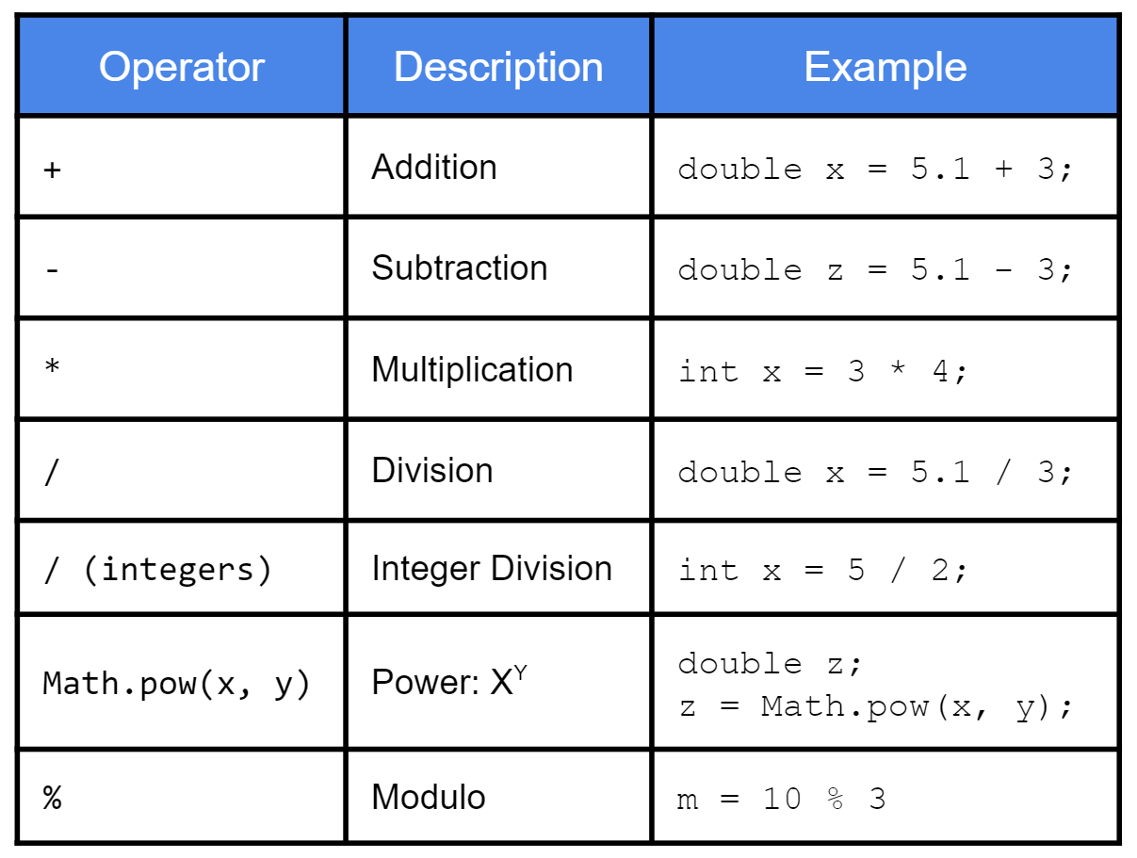
1.6
Arithmetic
Arithmetic operators in Java work very similarly to those in Python, including the order of operations and the way that they behave when combining integer and floating point values. Practice using the Java operators now.
Create a new Java class in the "src/main/java/unit01" folder in a file called "Arithmetic.java" and define a main method with the appropriate signature.
Use System.out.println to print the results of using arithmetic operators with combinations of different types, e.g.:
int and int
int and double
double and double
For example: System.out.println("12 * 3.6 = " + (12 * 3.6));
There is no need to declare variables, but remember that Java will consider a literal integer to be an int (32-bit) and a literal floating point value to be a double (64-bit).
Use the VSCode run button to run the class.

Slide 20
Strings & Characters
Java strings have a lot in common with Python strings.
They comprise characters.
Literal strings are enclosed in double-quotes ("").
Strings are immutable.
The + operator can be used to create a new string by concatenating two strings together.
Strings are reference types.
There are some key differences as well.
Literal strings cannot use single-quotes ('') or triple-quotes of either type.
Java includes a char type that represents a single character. Single quotes are used for char literals, e.g. 'a', '1', '&'.
The + operator can concatenate strings together with any other Java type.
Java strings do not work with square brackets ([]). Instead the charAt(int index) method is called on the string to get the char at a specific index.
Strings are not iterable.
Also like Python, Java makes use of a string literal pool.
If the same string literal is used in more than one place, a single copy of the string is stored and reused.
String is the type used for Java strings. String literals must be enclosed in double-quotes ("").
1 String aString = "Jason";
2 char first = aString.charAt(0);
3 char last = aString.charAt(4);
4
5 System.out.println(first);
6 System.out.println(last);
Java strings do not support the use of square brackets ([]), but the charAt(int index) method will return the char at a specific index.
As with Python, valid indices range from 0 to length-1. Java does not support negative indices.

Slide 21
1.7
Java Strings
Making the transition from Python strings to Java strings can take some getting used to, especially because you can't access individual characters in a Java string using []. Start getting used to using the s.charAt(index) to access the individual characters in Java strings.
String aString = "Jason";
char first = aString.charAt(0);
char last = aString.charAt(4);
System.out.println(first);
System.out.println(last);
Create a new Java class in the "unit01" folder in a file called "Strings.java" and declare a main method with the appropriate signature.
Create a String variable containing at least 5 characters using the literal of your choice.
Use the charAt(int index) method to print the first and last characters in the string.
Print at least 3 of the remaining characters.
Use the VSCode run button to run the class.
'J' | 'a' | 's' | 'o' | 'n'
0 | 1 | 2 | 3 | 4
Java strings are built on top of an array of characters, each of which is accessible via its index using charAt(int index).

Slide 22
Methods & Parameters
You should recall that a function that belongs to a class is called a method. All code in Java must be within the body of a class, therefore all functions in Java are methods.
Java methods must be declared between the curly braces ({...}) that define the body of a class.
There are some key differences between Python and Java.
There is no self parameter.
Like any other Java variable, parameters must be declared with a type as well as a name.
All methods must declare a return type. A method that does not return anything declares a void return type.
An access modifier may be used to set the visibility of the method outside of the class. In this unit, all of the methods that we write will be public.
In Python, a method that does not explicitly return a value returns None by default. In Java, a method with a void return type does not return anything at all.
Trying to assign the return value of a void method to a variable is a compiler error.
All of the methods that we write in this unit will be public (visible to all parts of the program) and static (called on the class, not an object).
All Java methods must declare a return type. A void return type indicates that the method does not return a value.
1 public static void example(int x, double y) {
2 System.out.println(x + " * " + y
3 + " = " + (x * y));
4 }
Parameters must declare a type as well as a name. When the method is invoked, a compatible argument must be provided for each parameter.
Notes:
In Python, every function returns a value.
✅ If there is no explicit return statement, the function returns None.
def greet():
print("Hello")
return “Hello”

Slide 23
1.8
Hello, Methods!
Java methods must declare types for any parameters and the type that will be returned by the method (or void if nothing is returned). Practice now by writing a Java method and calling it from main.
Hi.
Again, again.
Open the HelloWorld class that you wrote previously and define a method called "helloName" that declares String parameters for a first and last name.
Don't forget to make the method public and static.
Print a message in the format "Hello, <first> <last>!" to standard output.
Call your method from main.
Run the class.
public static void example(int x, double y) {
System.out.println(x + " * " + y
+ " = " + (x * y));
}

Slide 24
Return Values
All Java methods must declare a return type, even if no value is returned.
The return type is declared as part of the method signature.
Unlike Python, there is no default return type in Java. The void return type indicates that a method does not return a value of any type.
A void method cannot be assigned to a variable, and trying to do so will cause a compiler error, e.g. int x = someVoidMethod();
A void method cannot return a value, though it may use an empty return statement, e.g. return;
If a method declares a return type of anything other than void, then a value of that type must be returned by the method using a return statement, e.g. return 5;
This also means that, if there are multiple branching paths through the method, each and every branch must terminate in a return statement.
A method that does not return a value of the declared type will not compile.
A method that declares a void return type does not return a value of any type, though a return statement can be used without a value.
1 public static void someVoidMethod() {
2 System.out.println("no return");
3 return;
4 }
5
6 public int intReturn() {
7 return 5;
8 }
A method that declares a return type of any other type must return a value of a compatible type. If not, the method will not compile.
Assigning a method with a void return type to a variable of any type will cause a compiler error.

Slide 25

1.9
Calculon
In Python, all methods return a value (even if that value is None). In Java, a method must declare its return type - if the return type is not void, the method must return a value of the correct type or the program will not compile. Try writing a few methods that return values.
Create a new Java class in the "unit01" folder in a file called "Calculon.java".
Define a method for each of the four basic arithmetic operations, each of which declares two floating point parameters and returns a floating point result.
add
subtract
multiply
divide
Test your methods by calling them from main and printing the results to standard output.
Run the class.
public int intReturn() {
return 5;
}
Notes:
Python:
if x > 10:
print("x is greater than 10")
elif x == 10:
print("x is exactly 10")
else:
print("x is less than 10")

Slide 26
Conditionals
Recall that a boolean expression is one that, when evaluated, results in a boolean value, i.e. true or false.
Just like Python, logical and comparison operators can be combined to create complex boolean expressions in Java.
Also like Python, Java supports conditional statements that work very much the same.
if(expression) {...} - executes the statements in the body if the expression is true.
else {...} - executes the statements in the body if all of the preceding conditions are false.
The most notable difference is that Java does not include an elif statement.
Instead, else if(expression) {...} is used.
Python | Java | Example
not | ! | !a, !(a || b)
or | || | a || b
and | && | a && b
^ | ^ | a ^ b
is, is not | ==, != | a == b, a != b
== | == (primitives) equals(Object) | x == 5 a.equals(b)
<, <= | <, <= | a < b, a <= b
>, >= | >, >= | a > b, a >= b
1 if (a && b) {
2 System.out.println("foo");
3 } else if (b ^ c) {
4 System.out.println("bar");
5 } else {
6 System.out.println("foobar");
7 }
A side-by-side comparison of logical and comparison operators in Python and the equivalent operators in Java.
Notes:
^ → Exclusive OR
What ^ means (core idea)
XOR = true when values are different
a = 5 # 0101
b = 3 # 0011
print(a ^ b) # 6
0101
^ 0011
------
0110 → 6

Slide 27
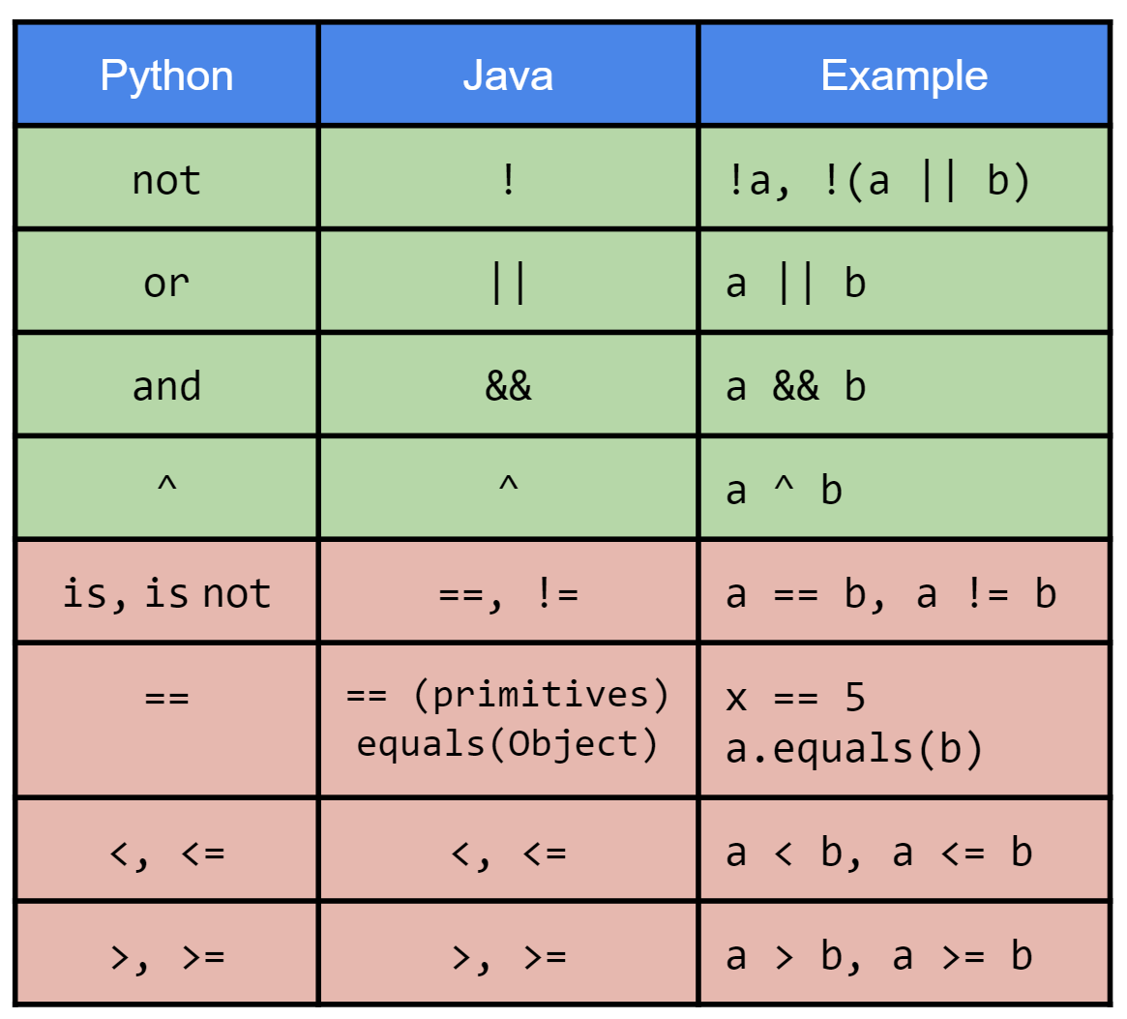
1.10
Conditioning
By now you have lots of experience using conditionals in Python. Conditionals in Java work exactly the same way, but use a different syntax. Practice the Java syntax by writing a method that prints a different message depending on whether or not a number is divisible by 2, 3, or 5.
Create a new Java class in a file named "Conditional.java" and define a method named "evenlyDivisible" that declares a parameter for an integer n.
Print exactly one of the following messages depending on the value of n:
The number is even
The number is divisible by 3
The number is divisible by 5
The number is odd but not divisible by 3 or 5
Call your method from main with several values of n.
Run the class.
if (a && b) {
System.out.println("foo");
} else if (b ^ c) {
System.out.println("bar");
} else {
System.out.println("foobar");
}
Notes:
Do print and also return showing all the code must return.

Slide 28
while Loops
Java while loops work exactly the same way as while loops in Python with a few small syntactic differences.
The boolean expression that controls the loop must be enclosed in parentheses (()).
If the body of the loop contains more than one statement, it must be enclosed in curly braces ({}).
Java also supports statements for more finely grained control of a while loop.
The break statement will terminate a loop immediately, regardless of the boolean expression.
The continue statement will stop the current iteration. The boolean expression will be evaluated to determine whether or not the next iteration should be executed.
A while loop will execute zero or more iterations depending on whether the boolean expression is true the very first time it is evaluated.
1 int i = 1048576;
2 while (i != 2) {
3 System.out.println(i);
4 i = i / 2;
5 }
The loop will continue iterating until the boolean expression evaluates to false.
The break and continue statements work the same as they do in Python and can be used for more finely grained control of the iteration.
Notes:
count = 0
while count < 5:
print(count)
count += 1

Slide 29
1.11
Counting Up with while
The while loop in Java works just like Python's while loop, but uses a different syntax (you may be sensing a theme here). Practice Java's while loop syntax by implementing a method that uses a while loop to print a count up from 0 to n.
In Java, the boolean expression used by a while loop must be enclosed in parentheses...
Create a new Java class in a file named "CountUp.java" and define a method named "countWhile" that declares a parameter for an integer n.
Use a while loop to print a count from 0 to n.
Return the sum of the numbers that are counted.
Call your method from main and print the sum.
Run the class.
1 int i = 128;
2 while(i != 2) {
3 System.out.println(i);
4 i = i / 2;
5 }
...and the statements in the body of the loop must be enclosed in curly braces ({}).

Slide 30
"Classic" for Loops
Java's "classic" for loop is a more syntactically compact version of the counting while loop.
The loop declaration includes three statements separated by semicolons (;).
The initialization statement initializes the counting variable and is executed exactly once before the first iteration, e.g. int i=1048576;
The boolean expression that controls the loop. It is evaluated before each iteration of the loop, e.g. i!=2;
The modification statement that is executed after each iteration of the loop, e.g. i=i/2;
All three statements are optional.
If omitted, the boolean expression is always true.
Java also includes a for each loop similar to Python's that works with iterable types.
We'll take a look at it later in this unit.
The "classic" for loop uses a C-like syntax to make a more syntactically compact version of a counting while loop.
1 for (int i=1048576; i != 2; i=i/2) {
2 System.out.println(i);
3 }
1 int i = 1048576;
2 while (i != 2) {
3 System.out.println(i);
4 i = i / 2;
5 }
The initialization statement, boolean expression, and modification statement are all included in the loop declaration.
Notes:
for i in range(5):
print(i)
Java
Basic
for (int i = 0; i < 5; i++) {
System.out.println(i);
}
Enhanced
int[] numbers = {1, 2, 3, 4, 5};
for (int n : numbers) {
System.out.println(n);
}
Gotcha question → Does not have to limit to just one syntax
for (int i = 0, j = 10; i < j; i++, j--) {
System.out.println(i + " " + j);
}

Slide 31
A Closer Look at "Classic" for Loops
A counting while loop has a few basic parts…
A for loop is a more compact syntax for all of the same parts.
The initialization of the counting variable, which happens before the first iteration.
The boolean expression that stops the loop. This is evaluated before each iteration.
The initialization of the counting variable, which happens before the first iteration.
The boolean expression that stops the loop. This is evaluated before each iteration.
int count = 0;
while(count < 11) {
System.out.println(count);
count++;
}
for(int c=0; c<11; c++) {
System.out.println(c);
}
The statement that modifies the counting variable. This is executed at the end of an iteration.
The statement that modifies the counting variable. This is usually executed at the end of an iteration.
Notes:
Use the file loop

Slide 32
1.12
Counting up with for
Python does not have a loop like Java's "classic" or "C-Style" for loop. However, it works just like a counting while loop with a more compact syntax. Practice the syntax now by implementing a second method that counts from 0 to n using a for loop.
Java's for loop is a syntactic shortcut for a counting while loop.
Open your CountUp class and define a method called "countFor" that declares a parameter for an integer n.
Use a for loop to print a count from 0 to n.
Return the sum of the numbers that are counted.
Call your method from main and print the sum.
Run the class.
The counting variable is initialized in the loop header. The boolean expression is evaluated before each iteration.
for(int i=1024; i != 2; i=i/2) {
System.out.println(i);
}
The modification statement is executed after each iteration.

Slide 33

1.13
Java Basics
Up to this point you have only written a small amount of Java code, so let's do a quick practice exercise so that you can continue to reinforce Java syntax. Write a new class that includes a main method that uses a loop to print the integers between 1 and 100 that are multiples of 3 or 7.
Create a new Java class in a file called "Basics.java" and define a main method with the appropriate signature.
Use a loop to print all of the integers that are multiples of 3 or 7 between 1 and 100.
Challenge: Do not print numbers that are multiples of both 3 and 7.
Run the class.
1 public class MyClass {
2 public static void main(String[] args) {
3 int x;
4 double pi = 3.14159;
5 System.out.println("Hello, GCIS-124!");
6 }
7 }
Java programs require a lot of scaffolding, even for something as simple as "Hello, World!"

Slide 34

1.14
Calculon++
In the last class, you wrote a four-function calculator in a class named Calculon. Let's practice writing methods by adding a fifth function; a raise method that uses a loop to compute and return an exponent.
Open your Calculon class and define a new method named "raise" that declares parameters for a floating point base and an integer exponent.
Use a loop to compute the result of raising the base to the power of the exponent.
Call your new method from main.
Run the class.
public static int factorial(int n) {
int result = 1;
while(n > 1) {
result = result * n;
n = n - 1;
}
return result;
}

Slide 35
Casting Numbers
In Python, type conversions are handled using the constructor of the desired type, e.g.
a_string = str(123)
a_list = list("abcdef")
In Java, converting a less complex type to a more complex type is considered safe because there is no risk of data loss. Such conversions may happen automatically, e.g.
long x = 123; // int to long
double y = 12.34f; // float to double
However, converting from a more complex type to a less complex type risks data loss and is considered to be unsafe. Attempting to do so will cause a compiler error (incompatible types), e.g.
int x = 3246123456l; // long to int
float y = 1234.567; // double to float
You may force the conversion by casting, wherein the desired type is specified in parentheses on the right side of the assignment statement, e.g.
int x = (int)3246123456l;
long y = (long)1234.567;
This is a signal to the compiler that it is OK if there will be some data loss, e.g. the fractional part of a decimal.
Safe Type Conversions (automatic) | Example
smaller integer larger integer | int x = 1234; long y = x;
integer floating point | int x = 1234; double y = x;
Unsafe Type Conversions (requires casting) | Example
larger integer smaller integer | long x = 1234l; int y = (int)x;
floating point integer | float x = 12.34f; int y = (int)x;
Conversions between incompatible types, e.g. boolean and int, will result in a compilation error under any circumstances (even with a cast).
Notes:
String.valueOf(int)General use✅ Yes
Integer.toString(int)

Slide 36

1.15
Casting
Casting is only necessary when assigning a value of a more complex type to a variable of a less complex type, e.g. a double value to an int variable. Try it out now to see what happens when you cast values of different types.
Sometimes casting can have… unintended consequences.
Create a new Java class in a file called "Casting.java" and define a main method with the appropriate signature.
Experiment with casting by creating variables different types and trying to cast them into variables of another type. Print the values before and after casting. Try at least two of the suggestions below:
int to long
long >3 Billion to int
char to int
int in the range 33 ≤ i ≤ 126 to char
boolean to int
Run the class.
double x = 47.2;
int y = (int)x; // cast needed
When casting, the type to cast into is specified in parentheses next to the value being cast.

Slide 37
Standard Input
System.out is a reference to standard output and the println and print functions can be used to direct output to the terminal.
Similarly, System.in is a reference to standard input, and it can be used to read user input from the terminal, but it's a little unwieldy to use.
As an alternative to System.in, Java provides the java.util.Scanner class, which can be used to read data from any input source, e.g. standard input, files, etc.
A Scanner needs to be told from where to read by passing the input source into its constructor, e.g. Scanner s = new Scanner(System.in);
Scanner provides lots of useful methods:
next() returns the next word typed by the user (up to the next whitespace).
nextLine() return everything up to the point where the user pressed the enter key.
nextInt(), nextLong(), nextFloat(), etc. returns the next word as the corresponding type.
It is considered good programming practice to close a Scanner when you are finished using it.
The Scanner class is in the java.util package, and so must be imported. Imports are done at the top of the class file.
import java.util.Scanner;
The new keyword will create a new Scanner by calling its constructor. The Scanner needs to be configured to read from a specific data source, e.g. standard input (System.in).
1 Scanner scanner = new Scanner(System.in);
2 System.out.print("Enter age: ");
3 int age = scanner.nextInt();
4 int months = age * 12;
5 System.out.println("Age in months: " + months);
6 scanner.close();
Methods like next(), nextLine(), and nextInt() will return input typed by the user into the terminal. The Scanner should be closed when it is no longer needed.
Notes:
Python
Using input() → Everything is read as string
Scanner also gives you ability to

Slide 38

1.16
Hello, You!
You may remember that "Hello, You!" is a modified version of the classic "Hello, World!" program that prompts the user to enter their name and prints a customized "Hello!" message to standard output. Practice using Scanner to implement it now.
Create a new Java class in a file named "Hello.java" and define a new method named "helloYou".
Prompt the user to enter their name.
Hint: the System.out.print() method will not terminate with a newline, so the user can type on the same line as the prompt.
Use a Scanner to read the user's input and store it in a variable.
Remember, Scanner is in the java.util package. Don't forget to import it!
Print a message in the format "Hello, <name>!"
Call your method from main.
Run the class.
import java.util.Scanner; // import!
Scanner scanner = new Scanner(System.in);
System.out.print("Enter age: ");
int age = scanner.nextInt();
int months = age * 12;
System.out.println("Age in months: " + months);
scanner.close();

Slide 39

1.17
Calculon+++
We'll be using the Scanner a lot to read user input from standard input. Let's practice a little more by making an improvement to the five function calculator by prompting the user to enter the values to add, subtract, multiply, divide, and raise.
Open your Calculon class and update your main method.
Prompt the user to enter two floating point operands.
Print the results of calling all five methods on your calculator.
Run the class.
import java.util.Scanner; // import!
Scanner scanner = new Scanner(System.in);
System.out.print("Enter age: ");
int age = scanner.nextInt();
int months = age * 12;
System.out.println("Age in months: " + months);
scanner.close();

Slide 40
JUnit Unit Tests
JUnit is a unit testing framework that is similar to pytest in Python.
You will write a separate JUnit test for each Java class in your program.
The unit test is a Java class. By convention, the unit test is named the same as the class under test with a "Test" suffix, e.g. "MyClassTest".
You will write one or more test methods for each non-trivial method in your Java class.
JUnit uses Java annotations to find test methods inside of your unit test.
@Test is used to annotate each test method.
JUnit and/or VSCode will not be able to find the tests if they are not annotated properly.
JUnit also includes many built in assertions, e.g.
assertEquals(expected, actual)
assertEquals(float1, float2, delta)
assertTrue(actual)
assertNotNull(actual)
etc.
Using JUnit with VSCode requires configuring your project to include the JUnit library.
Maven will take care of this for you, provided that you have installed and configured it.
Each test method is marked with the @Test annotation so that JUnit knows which methods to execute.
1 public class EuclidGCDTest {
2 @Test
3 public void gcd100() {
4 // setup
5 int a = 100;
6 int b = 60;
7 int expected = 20;
8
9 // invoke
10 int actual = EuclidGCD.gcd(a, b);
11
12 // analyze
13 assertEquals(expected, actual);
14 }
15 }
A good JUnit tests follow the same pattern as pytest: setup, invoke, and analyze using assertions.
Notes:
Python
assert age >= 18
assert not condition, “message”
assert item in collection
assert x > 0, "x must be positive"

Slide 41

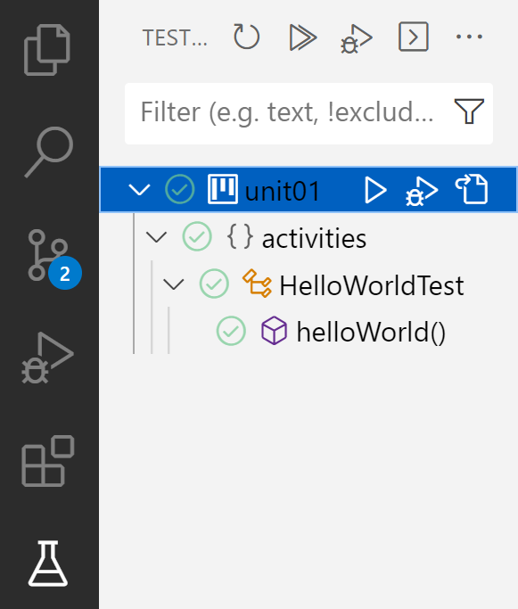


1.18
Running Your First JUnit Test
The project that you have been given should already be configured to run JUnit tests, including a "HelloWorldTest" that has been provided for you. Make sure that everything is configured properly by using VSCode's Test Runner ( ) to run the provided unit test now.
If everything is working as expected, you should see green check marks indicating that the test passed!
Open the provided HelloWorldTest. You can find it under "test" in your root project folder.
import org.junit.jupiter.api.Test;
public class HelloWorldTest {
@Test
public void helloWorld() {
assertEquals("Hello, World!",
"Hello, World!");
}
}
Open the VSCode Test Runner ( ) and use "Run Test" ( ) to run the provided test.

Slide 42
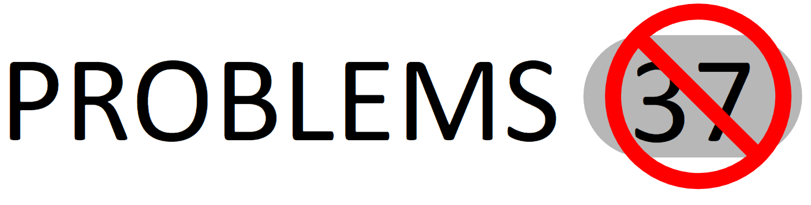

If VSCode has identified any problems, try to fix them. If you're not sure how, raise your hand and ask for help!
Whenever you see this image, it's a reminder to check your PROBLEMS tab.
And remember: it's not about avoiding making mistakes. It's about learning how to fix them as we make them.

Slide 43

1.19
Writing Your First JUnit Test
Now that we have verified that we can run JUnit tests and have moved all of our code into the right location in the project, let's write our own unit test. Tests in Java should be set up the same as they are in Python (setup, invoke, analyze) and should be small, fast, and repeatable.
Create a new JUnit test named "CalculonTest" in the same folder as "HelloWorldTest" and define a test method named "testAdd".
Make sure to add the @Test annotation to the method!
Call the static add method on your Calculon class and save the result in a new variable, e.g. float actual = Calculon.add(5.1f, 7.2f);
Use the JUnit assertEquals method to assert that the actual value matches the expected value.
Hint: only type the first few characters of the name, e.g. "assertE", and then use VSCode's autocomplete feature to import the assertEquals method from JUnit.
Click the flask icon in your VSCode sidebar to open the Java Test Runner.
Click the run all tests button at the top of the test runner.
You will see that VSCode runs each test method in each of your tests, usually from top to bottom.
If a test passes, it is marked with ✔ and if it fails, it is marked with 𝗫.
@Test
public void exampleTest() {
// setup
int x = 5;
int y = 2;
int expected = 7;
// invoke
int actual = x + 1;
// analyze
assertEquals(expected,
actual);
}

Slide 44
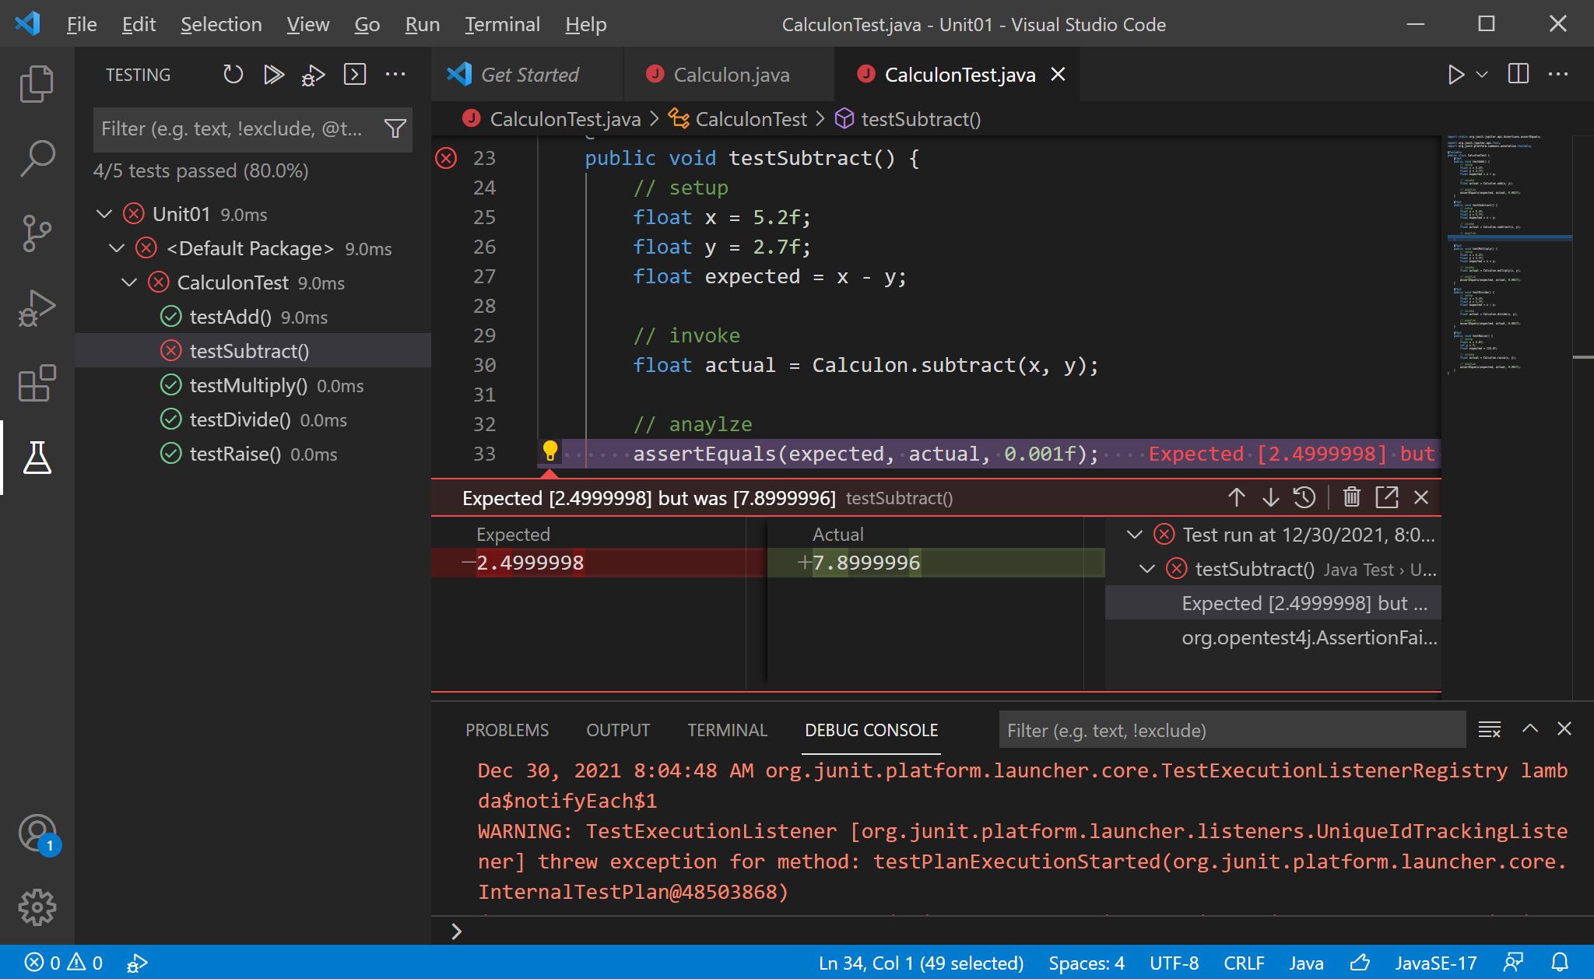
Test Output in VSCode
Filter to see all tests, only failed tests, or only tests that passed.
If a failing test is clicked in the tree on the left, the editor will jump to that test…
When expanded, the tree on the left shows tests that passed with a ✔ and tests that failed with an X.
…and show a detailed (if clunky) dialog explaining which assertion failed, and why.
The output from the tests is displayed in the Debug Console. But it's not very useful.

Slide 45
1.20
More JUnit Tests
We will be writing lots of JUnit tests this semester to verify that our code is working properly. Let's get some more practice by writing tests for some of the other functions for the Calculon five-function calculator. We will want at least one test for each function.
Open the CalculonTest JUnit test and define at least one test method for each of the remaining methods in your calculator.
subtract
multiply
divide
raise
After writing each new test, run your JUnit test using the Java Test Runner to make sure that the test passes.
Remember, if you'd like to see why a test failed, click on it in the test runner tree and the editor will jump to it and show you why.
Remember: you can also run your tests using Maven.
mvn clean compile test
What does it look like when a test fails?
@Test
public void exampleTest() {
// setup
int x = 5;
int y = 2;
int expected = 7;
// invoke
int actual = x + 1;
// analyze
assertEquals(expected,
actual);
}

Slide 46
1.21
Reverse a String
Let's practice some of the Java basics that we've learned earlier in this unit, including writing methods, returning values, and looping over strings; write a method that returns a reversed copy of a string.
int length = string.length();
char c = string.charAt(3);
String cat = "abc" + "def";
for(int i=5; i<11; i++) {
System.out.println(i);
}
Create a new Java class named "Miscellany" and define a method named "reverseChars" that declares a String parameter.
Use a loop to create a copy of the string with the characters reversed.
Remember you can use concatenation (the + operator) to concatenate anything onto a string.
Return the reversed copy.
Run the class.
Remember: you can access individual characters in a string using the charAt(index) method inside of a for loop.

Slide 47
Java Arrays
A data structure is a grouping of related elements.
In the previous course, we worked with lots of different data structures including lists, sets, dictionaries, stacks, and queues.
You should recall that an array is the most basic kind of data structure, and it has the following properties.
Arrays are fixed length; arrays are created to be a non-negative size, and the size never changes.
Arrays can store elements of any type.
Individual elements are accessed using an index that ranges from 0 to length-1.
A Java array is declared using any type with square brackets, e.g.
String[] strings;
int[] integers;
An array is initialized using the new keyword and the size of the array in square brackets, e.g.
integers = new int[10];
The length field can be used to get the length of the array, e.g. integers.length
Java fills each array with default values appropriate for the type.
0 for numeric types (including char).
false for booleans.
null for reference types.
Arrays are allocated as a contiguous block of memory that can be efficiently accessed using an index that ranges from 0 to length-1.
An array can be visualized as a table with a single row. The number of columns is determined by the length of the array.
0 | 0 | 0 | 0 | 0 | 0 | 0 | 0 | 0 | 0
0 | 1 | 2 | 3 | 4 | 5 | 6 | 7 | 8 | 9
Arrays are created to be a specific size using the new keyword, which tells Java to allocate memory and store something there.
In the case of an array, the memory allocated is a contiguous block large enough to hold the number of elements specified when the array is created.
Notes:
Python does not provide native array data type. We kind of used list to implement the feature
for (int num : numbers) {
System.out.println(num);
}

Slide 48
1.22
Array of Squares
Like so many other things we have talked about in this unit, arrays in Java are very similar to those that you used in Python. The only real difference is the syntax for creating and using them. Practice now by implementing a method that returns an array of squares.
int[] numbers = new int[5];
numbers[0] = 2;
numbers[1] = 3;
numbers[2] = 5;
numbers[3] = 7;
numbers[4] = 11;
for(int i=0; i<numbers.length; i++) {
System.out.println(numbers[i]);
}
String s = Arrays.toString(numbers);
Open your Miscellany class and define a method named "squares" that declares a parameter for an integer n.
Create an integer array large enough to hold n elements.
Use a loop to set the value at each index to the square of the index
i.e. 0², 1², 2², …, n-1².
Return the array.
Call your squares method from main and print the results.
Use the Arrays.toString() method to print your array to standard output (see the example to the left).
Run the class.
Creating an array works a little differently in Java, but using one is very similar to the arrays module in Python.

Slide 49
2-Dimensional Arrays
In Python we experimented with two-dimensional lists. In Java, it is possible to create two-dimensional arrays.
A 2D array is an array of arrays.
Like any other array, a two-dimensional array must be declared with a type, and can only be used to store values of that type.
Two-dimensional arrays are declared using two sets of square brackets, e.g. int[][] table;
2D arrays are initialized with two sizes, which you can think of as the number of rows and columns in the array, e.g. table = new int[4][6];
The values in a two dimensional array are accessed using two indices.
You can think of these as the index of the row and column of the data that you are looking for.
For example: int value = table[4][5] will retrieve the value from row 4, column 5 in the 2D array.
You can also fetch the array for an entire row all at once by using only one index.
For example: int[] row = table[3] will grab the array that contains the values in row 3.
You can depict a two-dimensional array with 4 rows and 6 columns as a table...
 | 0 | 1 | 2 | 3 | 4 | 5
0 | 5 | 3 | 7 | 0 | 0 | 0
1 | 13 | 16 | 0 | 3 | 4 | 17
2 | 2 | 10 | 5 | 6 | 5 | 14
3 | 1 | 18 | 11 | 4 | 3 | 12
The table is really an array of arrays. Each row is an array of values, e.g. row 0 is the array containing the values [5, 3, 7, 0, 0, 0].
Let’s take a closer look...

Slide 50
A Closer Look at Two-Dimensional Arrays
The first “dimension” is really just an array. Each value in the array is the address of another array.
And each “row” is really an array that contains elements of the specified type, e.g. integers.
0 | 1 | 2 | 3 | 4 | 5
5 | 3 | 7 | 0 | 0 | 0
0
1
2
3
While it can be handy to imagine such arrays as a table, it is possible for different rows to be different lengths...
0 | 1 | 2 | 3 | 4 | 5
13 | 16 | 0 | 3 | 4 | 17
0 | 1 | 2 | 3 | 4 | 5 | 6 | 7 | 8
2 | 10 | 5 | 6 | 5 | 14 | 2 | 31 | 7
0 | 1 | 2 | 3
17 | 19 | 23 | 4
These kinds of two-dimensional arrays are referred to as “ragged” because the uneven lengths create a ragged edge.

Slide 51
1.23
Multiplication Tables
You may remember using 2D-lists in Python to create multiplication tables. Let's try the same thing in Java using a two dimensional array instead.
// 5 rows, 4 columns
int[][] table = new int[5][4];
// row 1
int[] entireRow = table[1];
// the value at row 3 column 2
int individualValue = table[3][2];
for(int row=0; row<table.length; row++) {
for(int col=0; col < table[row].length; col++) {
System.out.println(table[row][col]);
}
}
Open your Miscellany class and define a new method named "multiplicationTable" that declares a parameter for rows and columns.
Create a two-dimensional array of the specified size.
Use loops to set the value at each index to the product of its row and column, starting at 1. Do not include 0s!
Call your method from main.
Use a loop to print each row in the table using the static Arrays.toString() method, e.g. Arrays.toString(table[0]) will print the first row.
Run the class.
In a 2D array a single index is used to get an entire row, and two indexes are needed to retrieve an individual value from a row.

Slide 52
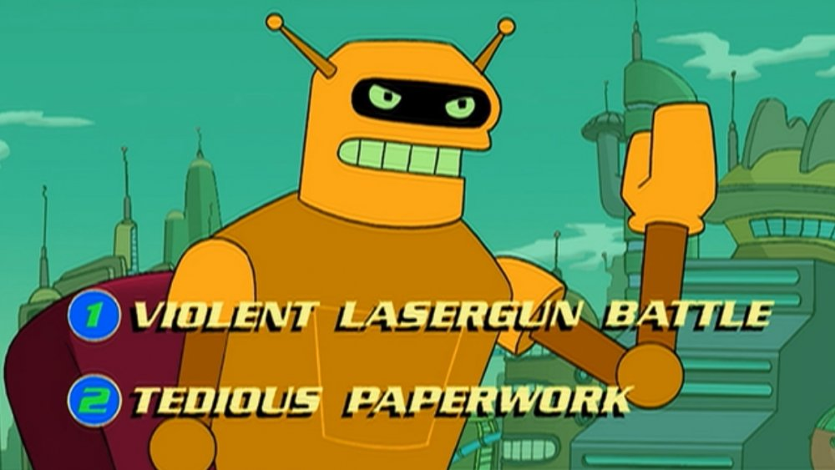
1.24
Invalid Input
We wrote many Python programs that expected the user to use standard input to enter numeric values into a prompt. If they entered non-numeric values, the program would crash with a ValueError. What happens if the user enters non-numeric data into your Calculon program?
Run the Calculon program.
Use standard input to enter non-numeric data for one of the two values.
What happens?
In Python, trying to convert an invalid string into an integer or float will cause an error.
If the error is not handled using try/except then the program will crash.

Slide 53
Java Exceptions
In Python, we saw lots of different kinds of errors, e.g.
Trying to convert a non-numeric string into an integer raises a ValueError.
Trying to index into an integer raises a TypeError.
Trying to access an invalid index in a list raises an IndexError.
Trying to open a file that doesn't exist raises a FileNotFoundError.
In Java these types of errors are called exceptions.
Specifically, trying to read non-numeric input from the user as an integer causes an InputMismatchException.
You may have seen other exceptions before, including IndexOutOfBoundsException and NullPointerException.
Java code that causes an exception is said to throw the exception.
As with Python, if nothing is done to handle the error, your program will crash.
In Python, we used try/except to handle errors that were raised.
In Java, try/catch works almost exactly the same way. One notable difference is that the catch must specify the type of exception that it handles.
Code that may throw an exception will crash your program if the exception is not handled.
The code may be enclosed in the body of a try block. The try must be followed by a catch that specifies the type of exception it handles.
1 Scanner scanner = new Scanner(System.in);
2 try {
3 System.out.print("Enter a number: ");
4 int x = scanner.nextInt();
5 } catch(InputMismatchException e) {
6 System.out.println("Invalid integer!");
7 }
The code in the catch block is executed iff an exception of a matching type is thrown in the try block.
Notes:
try:
x = int(input("Enter a number: "))
print(10 / x)
except ValueError:
print("Invalid number")
except ZeroDivisionError:
print("Cannot divide by zero")

Slide 54

1.25
Using try/catch in Java Programs
Handling errors in Java works a lot like it does in Python. Instead of using try/except, we will use try/catch to handle exceptions that may occur. Try it out by modifying your Calculon class so that it displays an error if the user enters invalid input to either prompt.
Scanner scanner = new Scanner(System.in);
try {
System.out.print("Enter a number: ");
int x = scanner.nextInt();
} catch(InputMismatchException e) {
System.out.println("Invalid integer!");
}
Open the Calculon class and navigate to the main method.
Use a try/catch to handle the exception that occurs if the user types invalid input.
Print an error message and exit gracefully.
Run your updated class and enter non-numeric data.
What happens?

Slide 55
 | javac and java. javac MyClass.java java MyClass | Scaffolding and standard output. public class MyClass { public static void main(String[] args) { System.out.println("Hello, World!"); } }
 | Maven, a Java build tool. mvn clean compile
 | Java packages for code organization. package unit01; | Variables, assignment, & primitive types. int x = 5; char y = 'y';
 | Variables, assignment, & primitive types. int x = 5; char y = 'y'; | Arithmetic operators and Math.pow(x, y). double y = x + 10; double z = Math.pow(x, y);
 | Strings and characters. String foo = "bar"; char c = foo.charAt(1); int length = foo.length(); | Methods, parameters, and return values. public static double example(double x, double y) { return x + y; }
 | Conditionals (if/else if/else) and boolean expressions. if (a && b) { } else if (c || d) { }else {} | While loops. int i = 0; while (i < 10) { System.out.println(i); i = i + 1; }
 | "Classic" for loops and the increment operator (++). for (int i=0; i<10; i++) { System.out.println(i); }
Unit 1: Python to Java

Slide 56
 | Casting numbers. double x = 5.5; int y = (int)x; | Standard input with Scanner. Scanner scanner = new Scanner(System.in); String line = scanner.nextLine();
 | Unit testing with JUnit. public class MyClassTest { @Test public void exampleTest() { assertEquals("Hello, World!", "Hello, World!"); } } | Java arrays and 2D-arrays. int[] x = new int[5]; x[2] = 7; int y = x[2]; int[] z = {1, 2, 3, 4, 5}; int[][] table = new int[10][5];
 | Java exceptions and try/catch. try { // do something } catch(InputMismatchException e) { System.out.println("Oh no!"); }
Unit 1: Python to Java

Slide 57


Summary & Reflection
What is one thing that you wish you knew more about as we move forward?
Java Classes
Methods & main
Standard Input/Output
Maven
Java Types & Operators
Conditionals & Loops
Unit Testing with JUnit
Arrays
File I/O
Exceptions
What is one new thing that you learned today?
What one question do you have about today’s class?
Please answer the questions above in your notes for today.

